Slide 2
Introducing Phonics
Phase One
Phase Two
Phase Three
Phase Four
Phase Five
Phase Six

Slide 3
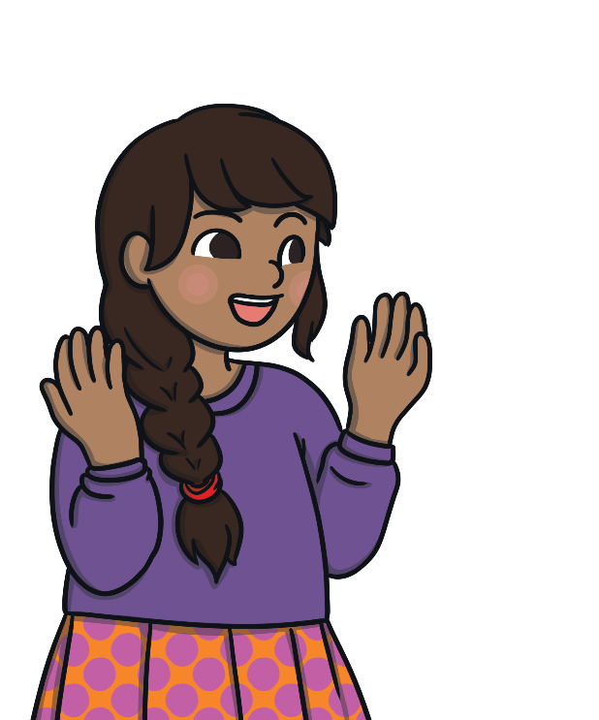
Did You Know…?
The English language has:
over 100 ways to spell those sounds
26 letters
44 sounds
x
u
a
e

Slide 4
Phonics Terminology
systematic synthetic phonics - The teaching of reading and spelling by breaking down words into the smallest unit of sound.
phoneme - Any one of the 44 sounds which make up words in the English language.
grapheme – How a phoneme is written down. There can be more than one way to spell a phoneme. For example, the phoneme ‘ai’ is spelt differently in each of the words ‘way’, ‘make’, ‘fail’, ‘great’, ‘sleigh’ and ‘lady’.
blending – Putting together the sounds in a word in order to read it, e.g. ‘f – r – o – g, frog’.
segmenting – Breaking a word into its constituent sounds in order to spell them, e.g. ‘frog, f – r – o – g’.
Notes:
It can be interesting to see how many ways there are to spell other sounds – try ‘igh’, ‘ee’ or ‘ow’.
A fun way to learn blending with young children is to talk to them in segmented words, for example ‘Please g – e – t’ the ‘m – i – l – k’ out of the ‘f – r – i – dge’.
When children begin to segment to spell they will often use the wrong spelling of phonemes, for example ‘I luv yoo’ or ‘Migh naym is…’. This is not a problem, as the key skill at this stage is that they can hear the sounds in the words and have a go at writing them down.

Slide 5


What Is Phonics?
reading and spelling
hearing, recognising and using sounds
routine and familiarity
focus on breaking down and building up words (segmenting and blending)
tricky/common exception words
Notes:
Typically, children begin to develop the listening skills essential to phonics in their preschool years. Some children begin to learn letter sounds at preschool but most children will begin their main phonics learning once they start their reception year at primary school (age 4-5). This teaching continues through year 1 (age 5-6) and into year 2 (age 6-7) until the child is a confident and fluent reader.
Once children are fluent readers, the emphasis in reading teaching moves more towards comprehension and analysis skills.
Book skills include holding books correctly, turning pages right to left, recognising that print represents words, talking about pictures, retelling familiar stories, asking and answering questions about stories and non-fiction texts and treating books with respect.

Slide 6
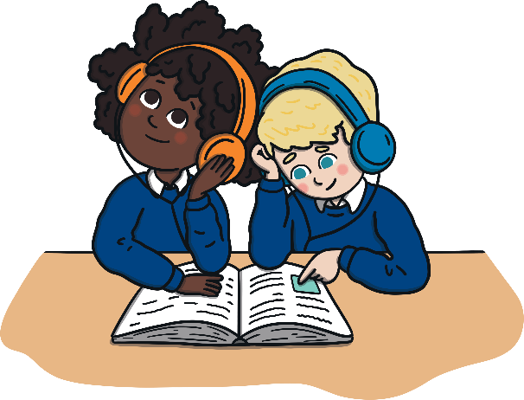
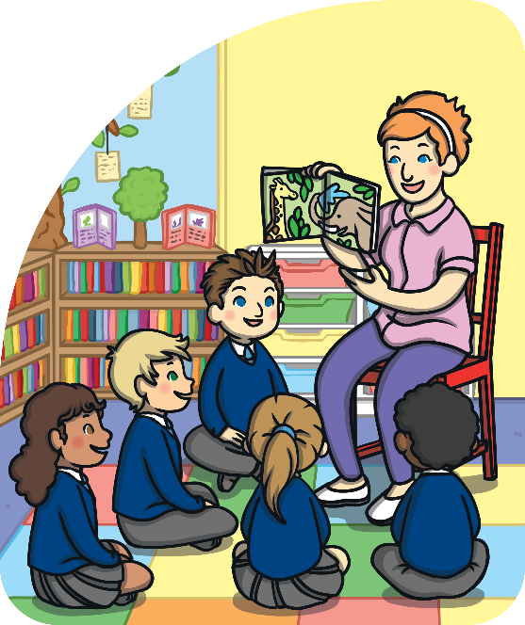
The Progression of Phonics
You may wish to change some of the wording in this section based upon the year groups that you cater for in your school as well as your chosen phonics scheme. Please delete this instruction.
Phase One - nursery and/or reception
Phase Two - reception
Phase Three - reception
Phase Four - reception
Phase Five - year 1
Phase Six - year 2
Notes:
Phonics is taught in phases and typically is taught between Nursery and Year 2. However, some children in older years might take part in phonics interventions if there are any gaps in their knowledge.
Typical progression in Phonics is as follows:
Phase One - nursery-reception
Phase Two - reception
Phase Three - reception
Phase Four - reception
Phase Five - year 1
Phase Six - year 2

Slide 7
Teaching Phonics
Children are taught reading and spelling daily throughout the week and each session will follow a structured format.
Revisit & Review
The activities used to teach will vary and can be adapted. They are multisensory and appeal to different learning styles. They involve games and individual and group activities as well as teacher-led sessions.
Teach
Practise
Teachers will assess children’s understanding throughout each session and will also assess knowledge of sounds to see whether a child is ready to move on to the next phase.
Apply
Notes:
Assessment at the end of a phase will usually involve asking children to name sounds to check that they know all of the Phase 2 sounds before they move on to Phase 3. Teachers may also assess ability to blend sounds to read words.

Slide 8



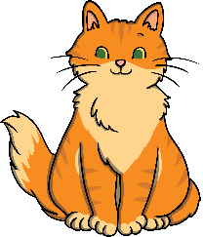

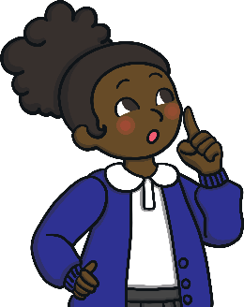

Phase One
Phase 1 has seven aspects, with a focus on listening skills.
Environmental sounds
Instrumental sounds
Body percussion
Rhythm and rhyme
Alliteration
Voice sounds
Oral blending and segmenting
Notes:
Environmental sounds – sounds we hear around us every day; listening to and imitating sounds; how to be a good listener. Ideas – make sounds to copy, e.g. sh sh sh, zzzzzz, p-p-p-p; go on a ‘listening walk’ – what can you hear?; talk about how to be a good listener; sing songs that require repetition and response, e.g. ‘Old MacDonald’.
Instrumental sounds – listening to and discriminating the sounds made by different instruments. Ideas – make sounds with a range of different instruments (non-musical instruments such as pots, pans, home-made shakers will all do); play an echo game where children have to copy a rhythm; hide an instrument behind a box or screen and play it, children have to say which instrument you are playing.
Body percussion – using the body to create sounds and follow a song, rhyme or beat. Ideas – sing songs that require actions, such as ‘Wind the Bobbin Up’, ‘Heads, Shoulders, Knees and Toes’, ‘If You’re Happy and You Know It, Clap Your Hands’; pass a body percussion sound around a group, e.g. sit in a circle or opposite one another, take turns to produce a body percussion sound which is then passed on, e.g. tap on shoulders, clap hands, stamp feet.
Rhythm and rhyme – recognising rhythms and rhymes in songs, speech and nursery rhymes. Ideas – sing and chant rhyming songs; read stories with repetition and rhyme, e.g. ‘The Gingerbread Man’, ‘Each Peach Pear Plum’; play a matching game with pictures of rhyming objects, e.g. frog/dog, hat/cat, mouse/house; clap the rhythm of phrases and rhymes or the syllables in words or names; play ‘I Spy’ – ‘I spy, with my little eye, something that rhymes with….’ Example game on next slide.

Slide 9
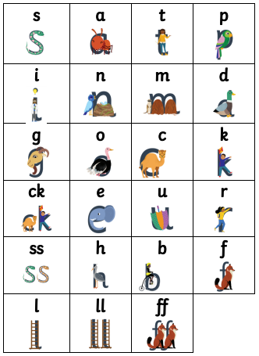
Phase Two
Notes:
Set 1: s, a, t, p
Set 2: i, n, m, d
Set 3: g, o, c, k
Set 4: ck, e, u, r
Set 5: h, b, f, ff, l, ll, ss
Phase 2 usually begins when children start their formal education in reception, though some preschools may also begin to teach letter sounds.

Slide 10
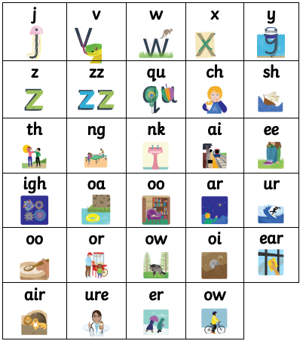
Phase Three
Notes:
Set 6: j, v, w, x
Set 7: y, z, zz, qu
Consonant digraphs: ch, sh, th, ng
Vowel digraphs: ai, ee, igh, oa, oo, ar, or, ur, ow, oi, ear, air, ure, er

Slide 11
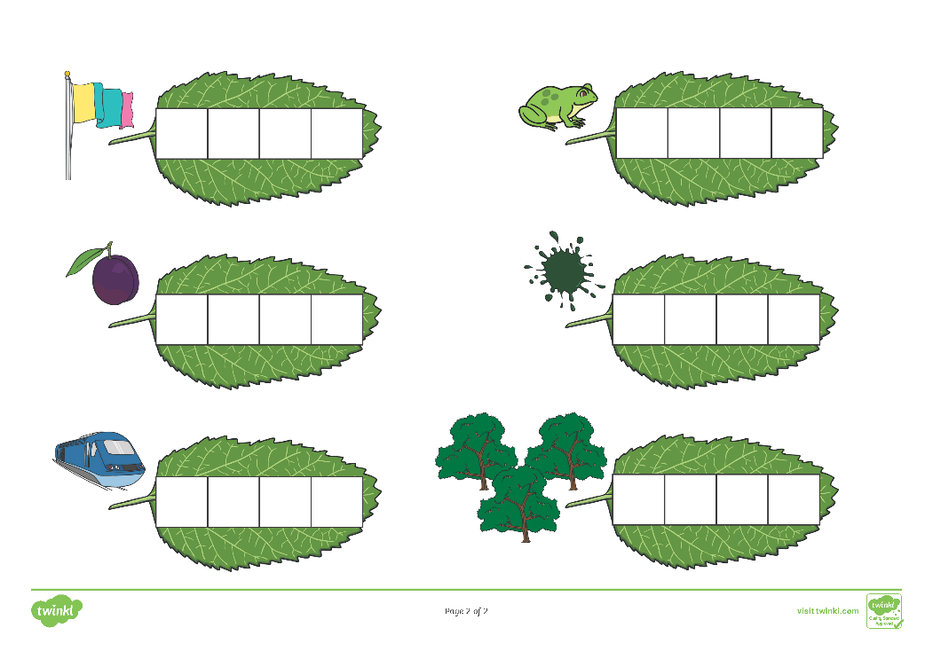
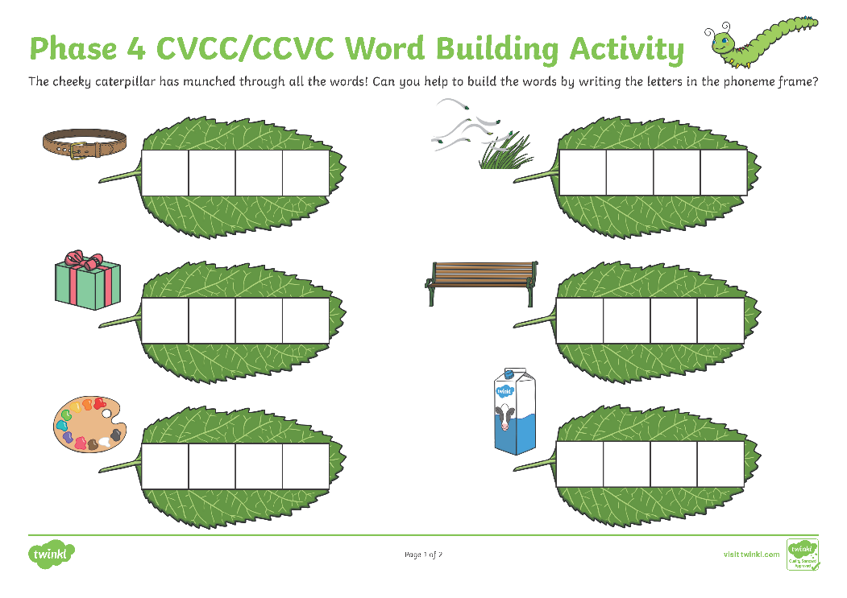
Phase Four
Notes:
Set 6: j, v, w, x
Set 7: y, z, zz, qu
Consonant digraphs: ch, sh, th, ng
Vowel digraphs: ai, ee, igh, oa, oo, ar, or, ur, ow, oi, ear, air, ure, er

Slide 12
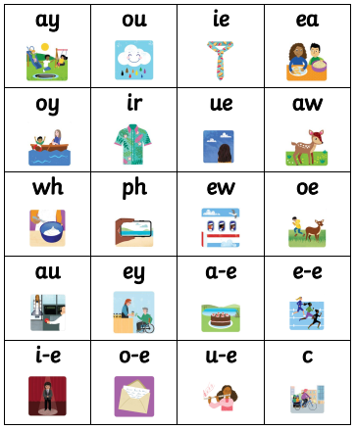
Phase Five
Notes:
Children will be taught new graphemes and alternative graphemes for the sounds they already know. They will begin to learn to choose the appropriate grapheme when spelling. The children will be automatically decoding a large number of words for reading by this point.

Slide 13
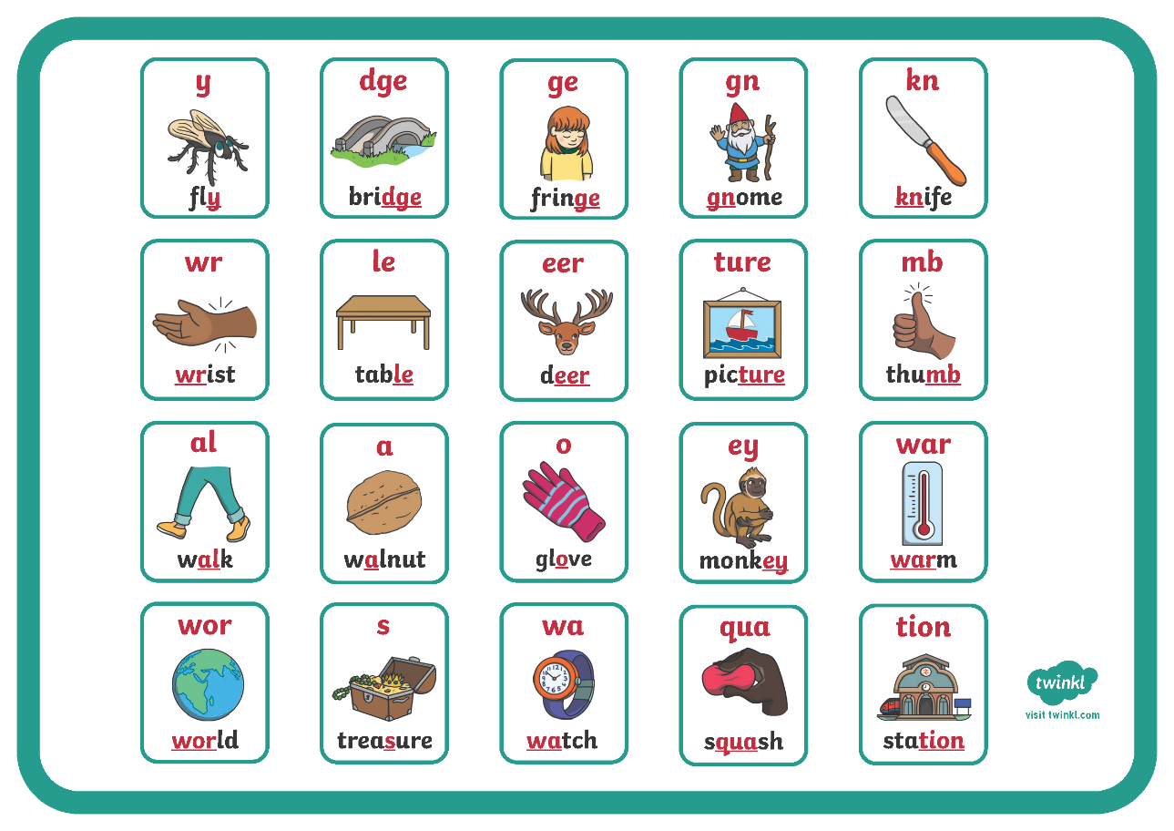
Phase Six
Notes:
In Phase 6, children will be reading longer and less familiar texts independently and fluently. It is crucial that, at this point, children are now reading to learn and reading for pleasure.
Children should be able to read the 300 high-frequency words. At this point, it is important that comprehension strategies are developed so that children clarify meaning, ask and answer questions about the texts that they are reading, construct mental images during reading and summarise what they have read.
In spelling, children are introduced to the adding of suffixes and how to spell longer words. Throughout the phase, children are encouraged to develop strategies for learning spellings.

Slide 14
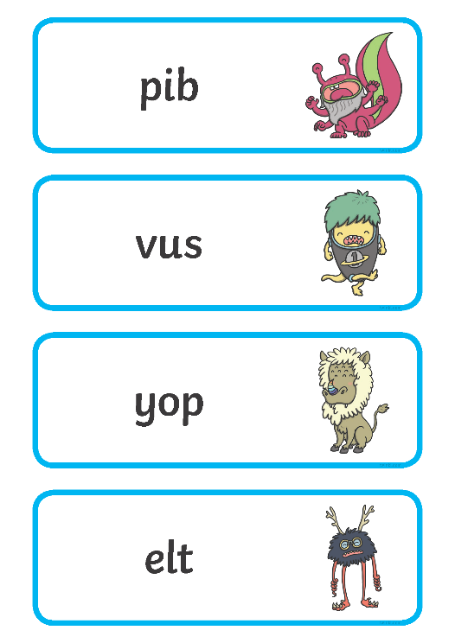
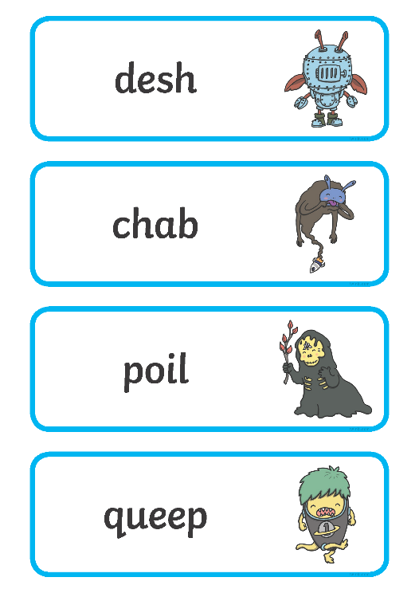
The Year 1 Phonics Screening Check
In June, all year 1 children are expected to complete the year 1 Phonics Screening Check.
The aim is to check that a child is making progress in phonics. They are expected to read a mixture of real words and ‘nonsense’ words.
The outcome of this check enables practitioners to see if any children may need additional support to help them make progress in year 2.
Notes:
Pupils who have achieved the expected standard at the end of year 1 will have experience of decoding all of the types of words that appear in the year 1 phonics screening check. They will know the correct grapheme to go with most sounds and be able to blend phonemes in words in the screening check.
‘Nonsense’ words or ‘alien’ words are designed to test pure phonic ability rather than knowledge of words. Examples might include ‘baf’, ‘gip’, ‘leet’, ‘stoof’.
For more information about the format of the phonics check, see Twinkl’s ‘Year 1 Phonics Screening Check’ Powerpoint.

Slide 15

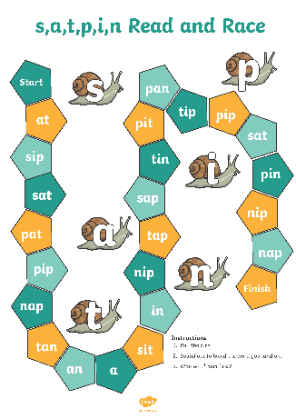
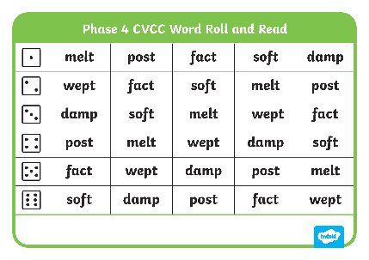

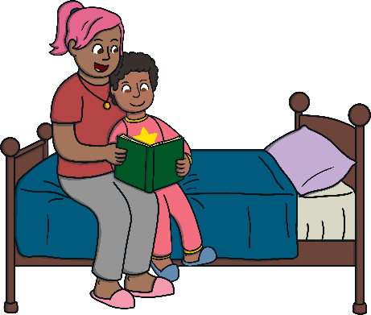
Helping Your Child at Home
play games
provide opportunities for writing
      provide opportunities for reading

